Slide 1

BTECH VI SEMESTER
ExEEd – RESEARCH BASED LEARNING
TOPIC :
USE OF COCONUT SHELL AS PARTLY SUBSTITUTION OF COARSE AGGREGATE
PRESENTED BY :
S.SAI PRANITH
21955A0109
CIVIL ENGINEERING

Slide 2
ABSTRACT
Concrete is a premier construction material consisting of natural aggregate. Due to rapid industrialization and constructions in developing country like India, natural resources are depleting constantly. Search of alternative material for making concrete is a prime need in present scenario. Environmental issues; restrictions on local & natural access or sources and
dispose of waste material are gaining great importance. Coarse aggregate is a major ingredient for making concrete for various types of construction works, including infrastructure development, low and high-rise buildings and domestic developments. It occupies about 65-80% part of concrete. Coconut Shell is a waste, generated by industrial and agricultural processes, and has created disposal and management problems that pose serious issues of environmental pollution. The waste coconut shell may be utilized to replace natural coarse aggregate.

Slide 3
In present study, compressive strength of concrete of M - 20 grades has studied by replacing natural coarse aggregates at 0%, 5%, 10%, 20% and 30%, by weight with coconut shell. Compressive strength of coconut shell concrete has been evaluated on 7, 14, 21 and 28 days. The compressive strength of coconut shell concrete was reduced as percentage replacement increased. Concrete mixtures were tested and compared in terms of compressive strength of the conventional concrete. The study result shows that Coconut Shell Concrete (CSC) can be used as light weight concrete. Use of Coconut Shell as a substitute of aggregate will not only is cost effective and eco friendly, but also help to resolve the problem of shortage of conventional material such as coarse aggregate. Use of such materials also reduces the problem of disposal of waste material.

Slide 4
INTRODUCTION
Infrastructure development across the world created demands for construction material. Concrete is the premier civil engineering materials used in the structure. Concrete manufacturing involves consumption of ingredients like cement, aggregates, water and
admixtures. Among all the ingredients, aggregates form the major parts. Production is expected to increase to than billions tons per year by the year. Use of natural aggregates in such a rate leads to a question about the of natural aggregate sources. Using alternative materials in place of natural aggregates in concrete production makes concrete as sustainable and environmentally friendly construction material. The chemical composition of coconut shell is similar to wood and it contains 33.61% cellulose, 36.51 % lignin and
0.61% ash.

Slide 5
Lightweight aggregate concrete can be used produced using a variety of lightweight aggregate. Lightweight aggregate can be originated from natural materials like pumice, the thermal treatment of natural raw materials like clay slate or shale. The other byproduct may include fly ash. The required properties will have bearing on the best type of lightweight aggregate used. the benefits of using lightweight aggregate concrete includes reduction in dead load, improved thermal properties, improved fire resistance and reduction in formwork.

Slide 6
OBJECTIVES
The use of coconut shell as a substitute for coarse aggregate in concrete can have several objectives. Here are some common objectives for utilizing coconut shell in this manner:
Sustainability: Coconut shell is a renewable and abundant resource, making its utilization in concrete a sustainable choice. By using coconut shell as a substitute for coarse aggregate, the demand for traditional aggregate materials can be reduced, resulting in a more environmentally friendly construction practice.
Waste reduction: Coconut shells are often considered agricultural waste and are typically discarded after the extraction of coconut meat and water. By incorporating coconut shells into concrete, it provides a means of utilizing this waste product effectively and diverting it from landfills.
Lightweight concrete: Coconut shell is relatively lightweight compared to traditional coarse aggregates such as gravel or crushed stone. By using coconut shell in concrete, it is possible to produce lightweight concrete, which can have benefits in certain applications. Lightweight concrete reduces the overall weight of structures, allowing for easier handling, transportation, and improved seismic performance.

Slide 7
4.Thermal insulation: Coconut shell possesses natural insulating properties due to its low thermal conductivity. Using coconut shell in concrete can contribute to improved thermal insulation of structures, resulting in reduced energy consumption for heating and cooling purposes.
5.Cost-effectiveness: Depending on the location and availability, coconut shell as a substitute for coarse aggregate can potentially offer cost advantages over traditional aggregates. If coconut shells are locally sourced and readily available, it can result in cost savings for construction projects.
6.Appeal: Coconut shell aggregates can add a unique and natural aesthetic to concrete. The texture and appearance of coconut shell in concrete can provide a distinctive visual appeal, making it suitable for architectural applications where a distinctive look is desired.
7.Improved workability: Coconut shell can contribute to improving the workability of concrete mixtures. Due to its irregular shape and texture, coconut shell particles can enhance the cohesiveness and reduce the segregation of the concrete mix, resulting in improved workability during placement and compaction.
Notes:
South India Placed @ 44
South India Placed @ 15
4/5 rating
In South India Placed @ 27
India Rank-band: 51-65

Slide 8
EXPECTED OUTCOMES
Lightweight Concrete: Coconut shell is significantly lighter than traditional coarse aggregates such as granite or gravel. Therefore, incorporating coconut shell into concrete can result in the production of lightweight concrete. This can be advantageous in applications where weight reduction is desired, such as in the construction of low-rise buildings or precast elements.
Improved Thermal Insulation: Coconut shell has natural insulating properties due to the presence of air pockets within its structure. By using coconut shell as a coarse aggregate substitute, the resulting concrete can exhibit improved thermal insulation compared to conventional concrete. This can be beneficial in reducing heat transfer through walls and structures, leading to energy savings in buildings.
Environmental Sustainability: The use of coconut shell in concrete can contribute to environmental sustainability. Coconut shells are considered a waste material in many coconut-producing regions, and utilizing them as a construction material can help reduce waste accumulation and promote recycling. Additionally, using coconut shell as a substitute for coarse aggregate can decrease the demand for traditional aggregates, which often require mining or quarrying operations that can have negative environmental impacts.

Slide 9
4.Lower Material Costs: In some regions where coconut shells are readily available, using them as a substitute for coarse aggregate can potentially lead to cost savings. Coconut shells may be obtained at a lower cost or even for free, reducing the overall material expenses for concrete production. This cost advantage can be particularly relevant in areas where traditional coarse aggregates are expensive or scarce.
5.Reduced Density and Strength: One potential drawback of using coconut shell as a coarse aggregate substitute is a decrease in the density and strength of the resulting concrete. Coconut shells are less dense and have lower compressive strength compared to traditional coarse aggregates. Consequently, the use of coconut shell may result in a reduction in the overall strength and load-bearing capacity of the concrete. This limitation should be carefully considered and appropriate design adjustments made to ensure structural integrity.

Slide 10
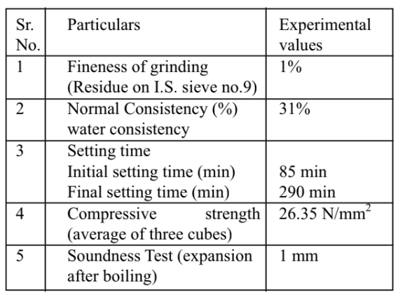
MATERIALS
Material Specification:
For the production of concrete, the constituent materials are cement, fine aggregate, coarse aggregate and water. To get better workability and strength, the material used should have better quality. To maintain the safety of any structure, provisions are provided as per IS 456:2000.
Cement:
In the experimental work cement used is Ordinary Portland cement. Various properties were evaluated such as fineness of cement, setting time, soundness test and compressive strength
Table 1. : Properties of cement

Slide 11
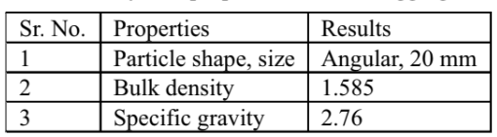
Fine Aggregate:
The various properties of fine aggregate such as specific gravity, fineness modulus, bulk density were determined as per IS 456:2000. Locally available sand was used as fine aggregate in the experimental work. The test is carried out for deciding the fineness modulus. Also the sieve analysis is carried out. Fineness modulus of sand is found to be 3.25 and it confirms to grading zone II as per grading limit for fine aggregate as per IS 383:1970. Fineness modulus is well within 2.5 to 3.37.the bulk modulus is found to be 2.65.
Coarse Aggregate:
Coarse aggregate of maximum size 10 mm used in the experimental work. Coarse aggregate were tested for different properties such as fineness modulus, bulk modulus as per IS 383:1970(3).
Table 2 : Physical properties of coarse aggregate

Slide 12
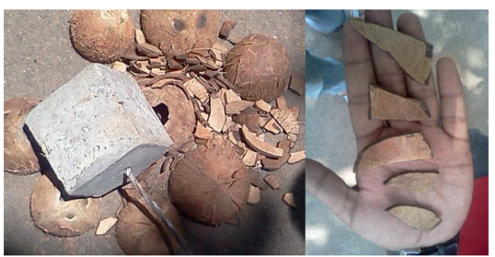
Coconut shell:
Coconut shells used in the study are brought from local temple. The coconut shells are sundried for five days before using it as an aggregate. The cleaning of coconut shell is carried with the help of sand paper, the smaller extractions on the outer face of coconut is cleaned with the help of water. The outer shell is then broken in smaller parts up to 20 mm. The broking of coconut shell is done with the help of 30 kg hammer. Then the broken pieces are passed through IS 20 mm sieve and pieces are retained on a IS 16mm sieve are used.
Water:
The water used in the study was clean and clear. It was free from bacteria and other impurities. There was no acid content in it. The water cement ratio for the concrete mix is 0.6.

Slide 13
EXPERIMENTAL METHODOLOGIES
The study is conducted to analyze the compressive strength of concrete when the natural coarse aggregate is partially replaced with waste coconut shell respectively. Concrete mix is designed as per IS: 10262-1982, IS: 456-2000 for the nominal concrete. The grade of concrete, which we adopted, is M-20. The concrete mix proportion (cement: fine aggregate: coarse aggregate) is 1:1.5: 3 by volume and a water cement ratio of 0.50.The Compressive strength tests were done on compression testing machine using cube samples.
The natural coarse aggregates were replaced with coconut shell as 0%, 5%, 10%, 20% and 30% by weight of M-20 grade concrete. Cubes of OPC (150mm × 150mm × 150mm) were examined and results were analyzed after curing of 7days, 14days, 21 days and 28 days. Due to high water absorption of coconut shell, they were presoaked in water for 24 hours, prior to mixing. Results obtained from the replacement are compared with data from a Conventional concrete.

Slide 14
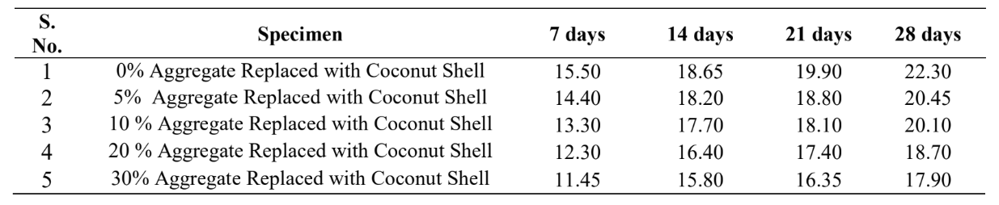
TABLE 3 : Comparison of Compressive Strength (N/mm2) CSC in 07, 14, 21, 28 days ( AS REFERENCE )

Slide 15
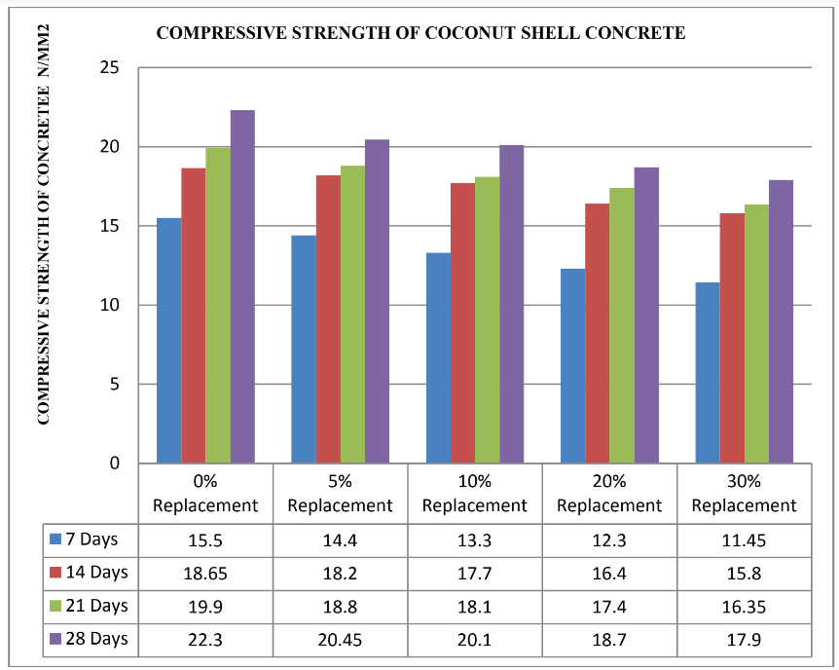
FIGURE 1: Comparison of Compressive Strength of Coconut Shell Concrete (REFERENCE )

Slide 16
RESULTS
In the present work coarse aggregate is replaced with the coconut shell, by volume. Specimens were casted by replacing 0%, 10%, 20% and 30% of coarse aggregate with coconut shell. Tests were conducted on the cast specimens after 7, 14, 21 and 28 days as mentioned in the IS code.
the compressive strength holds well up to 10% replacement of coarse aggregate by coconut shell. The percentage as increases above 10% the compressive strength decreases significantly.

Slide 17
CONCLUSIONS
On 10% partial replacement of natural coarse aggregate with Waste Coconut Shell, Compressive Strength of coconut shell concrete has obtained 20.10 N/mm2 at 28 days. Thus, making the replacement both technically and economically feasible and viable. On further replacement, decrease in the compressive strength of Coconut Shell Concrete has been observed.
Coconut shell can be grouped under lightweight aggregate because 28 day air dry densities of coconut shell aggregate concrete are less than 2000 kg/m3. Actual density of coconut shell is in the range of 600-800 kg/m3.
Experimental results and discussions of researches on coconut shell confirm that the coconut shell has potential as lightweight aggregate in concrete. Also, using the coconut shell as aggregate in concrete can reduce the material cost in construction because of the low cost and its abundant agricultural waste.

Slide 18
Coconut Shell Concrete can also be for non structural members e.g. partition wall, hollow concrete brick, floors tiles etc. Even after more than 10% partial replacement of coconut shell with aggregate.
Use of coconut shell waste as aggregate will reduce depletion of natural sources of conventional aggregate and will also be helpful to make eco - friendly environment.

Slide 19
REFERENCES
1. J. M. Crow, (2006) “The Concrete Conundrum”.
2. Amarnath Yerramala Ramachandrudu C, “Properties of Concrete with Coconut Shells as Aggregate Replacement,” International Journal of Engineering Inventions, 1(6) (2012).
3. A short and W.Kinniburgh, Lightweight Concrete, Applied Science Publishers, London.
4. Y. O. Daniel, “Experimental Assessment on Coconut Shell as aggregate in concrete”, International Journal of Engineering Science Invention, 2(5), pp. 07-11 (2013).

Slide 20


